Slide 1

MyTab.com

Slide 2
The Client
Jay Malejki
The Supervisor
Prof. William .Y. Arms

Slide 3
The Team
Deepthi Rajagopalan
Prasannjit Kumar
Prasaanth Neelakandan
Ravi Kodali
Sasank Krishna Talsilla
Shivam Patil
Sravani Burela
Sruja Aluri

Slide 4
Goals
Create a Phase 1 prototype web site with a "master account" for accessing multiple online accounts
The user should be able to browse all his/her accounts under single tab of a browser
The website should be capable of eliminating the need to continually retype usernames and passwords for each individual account

Slide 5
Scope
The MyTab application will support a fixed set of Cornell University accounts
Users will be able to create a MyTab account and login
Users will have the ability to add accounts from the list provided by MyTab, by entering the account’s credentials

Slide 6
Scope
The user will be able to access any added account by clicking on the account’s thumbnail without entering the credentials
MyTab will allow the user to view selected accounts and navigate between them under a single tab

Slide 7
Functional Requirements
Functionality:
Register
Login
Add Accounts
Select Accounts
Switch and Browse Accounts
Logout

Slide 8
Functional Requirements
User Interface:
Logo and Colors as specified
Interface to support Registration, Password
Reset
Interface to support Login, Logout
Navigation Bar , Thumbnails for browsing and
switching between accounts

Slide 9
Functional Requirements
Data
Credential Storage Encryption
Data Validation
Data deletion support

Slide 10
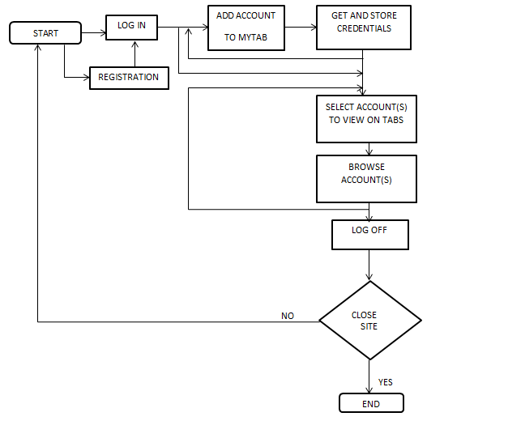
Flowchart for User Interaction

Slide 11
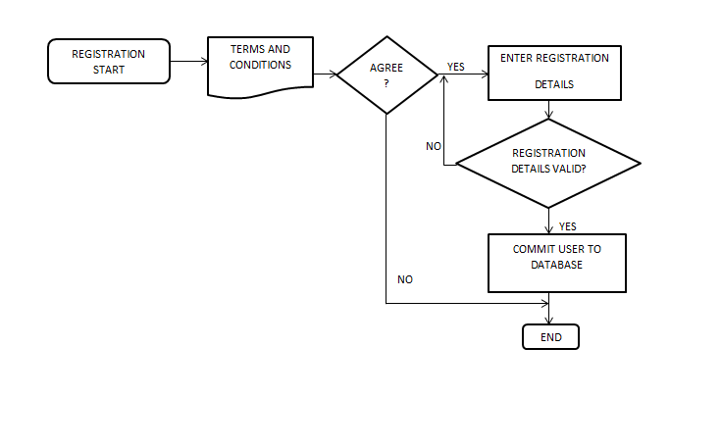
Flowchart for Registration

Slide 12
Non – Functional Requirements
Usability
Portability
Security
Performance
Modifiability
Legal Requirements

Slide 13
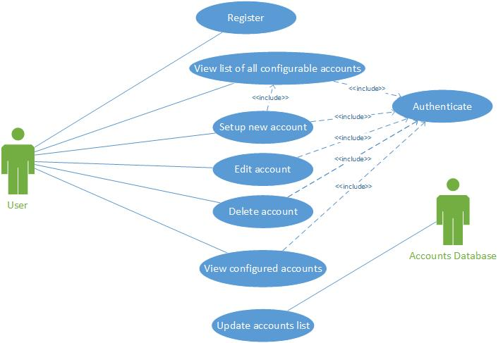
Use Case Diagram

Slide 14
Design
Back – End Design
ER Diagram
Database Design
Front –End Design
User Interface Design

Slide 15
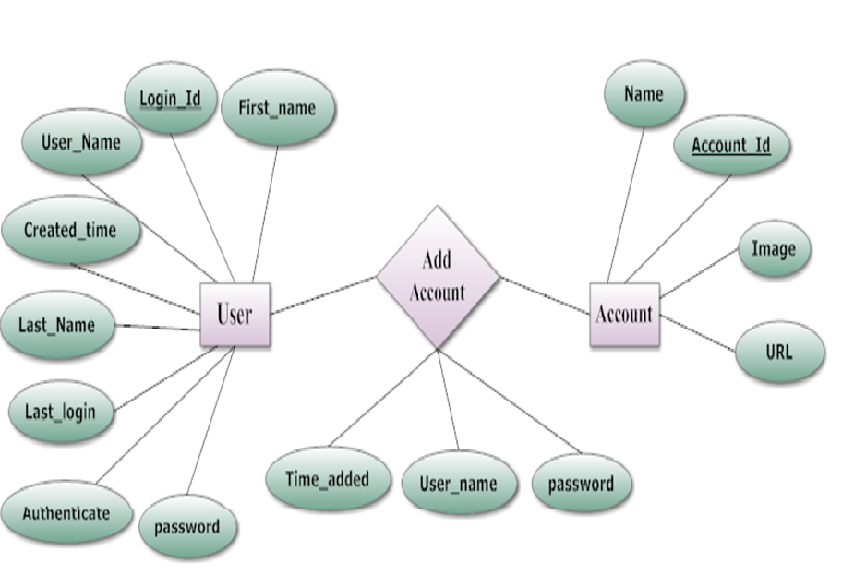
ER Diagram

Slide 16
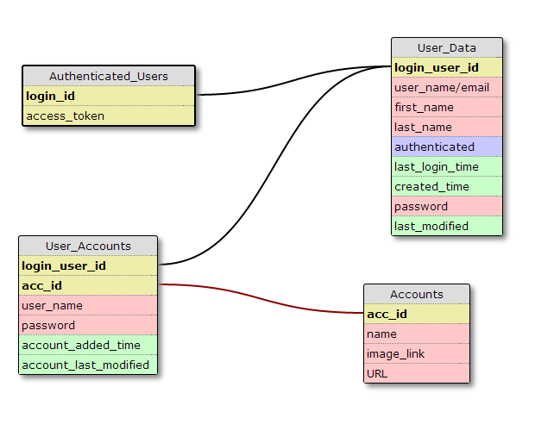
Database Design

Slide 17
Technical Issues
Cross-browser compatibility
Extending code base
Database constraints

Slide 18
Progress
Changes In Scope
First Increment Report
Second Increment Goals
Gantt chart

Slide 19
Changes In Scope
• Adding Social Networking Accounts to the
MyTab page, presented “Same origin policy”
issues.
• The client has agreed to change the scope to
support multiple accounts for large
institutions.

Slide 20
Changes In Scope
As per modified client requirements, “Cornell University Accounts” to be added to the MyTab page
Currently working on encryption of username and password of 3rd party websites on MyTab page

Slide 21
First Increment Report
Requirement Analysis and Feasibility
UI Mock Ups
Database schema
Login and Sign-up Pages

Slide 22
Second Increment Goals
Construction of main Homepage.
Add/Remove accounts
Accessing the added accounts on the MyTab page

Slide 23
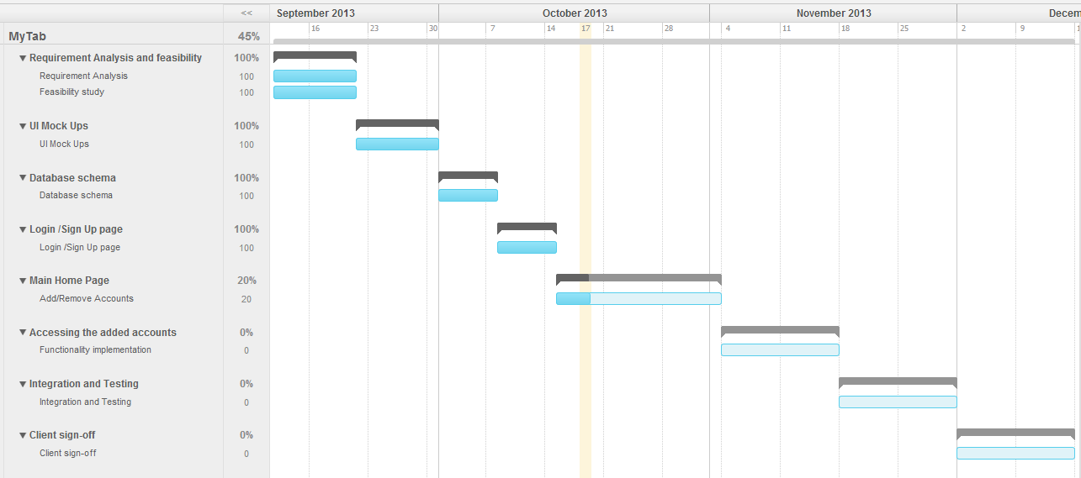
Gantt Chart

Slide 24
Demo

Slide 25
Questions

Slide 26
Thank You

